Slide 1
Python programming
Introduction to python

Slide 2
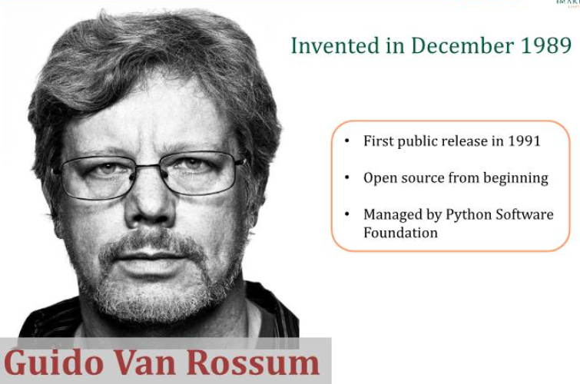

Slide 3
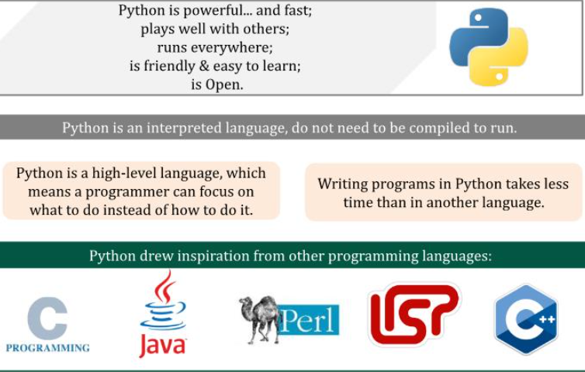

Slide 4
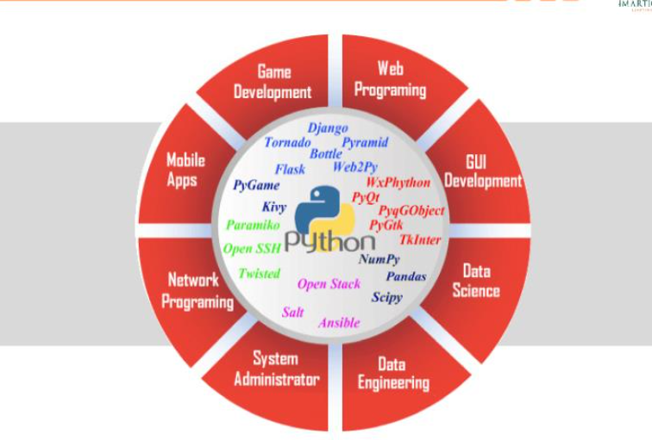

Slide 5
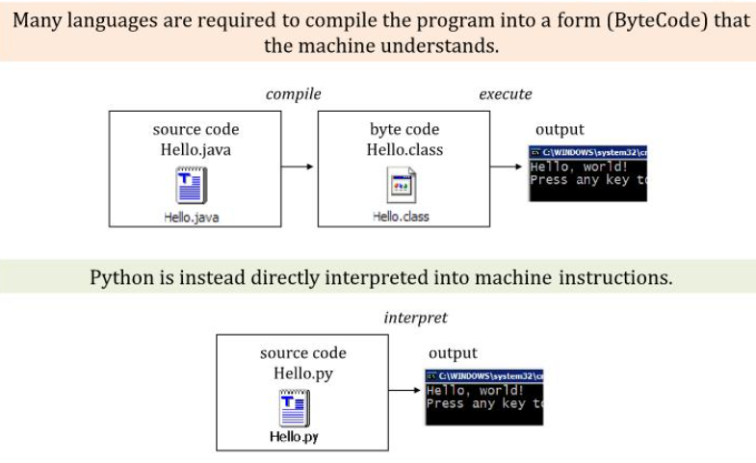

Slide 6
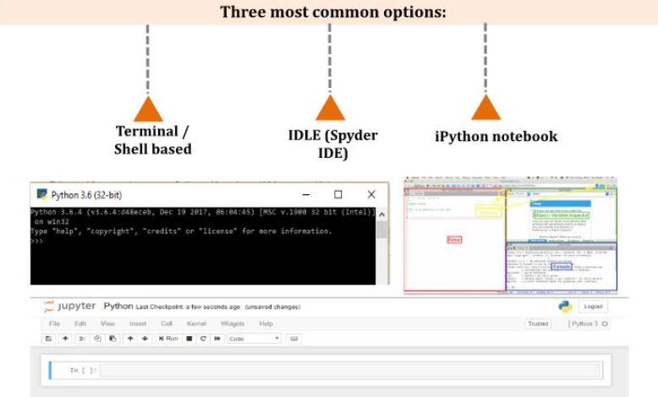

Slide 7
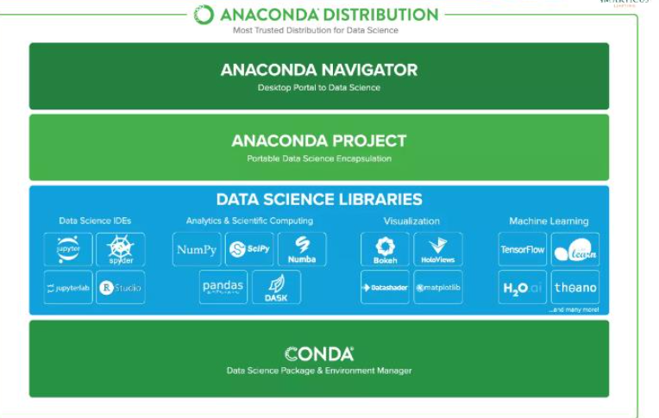

Slide 8
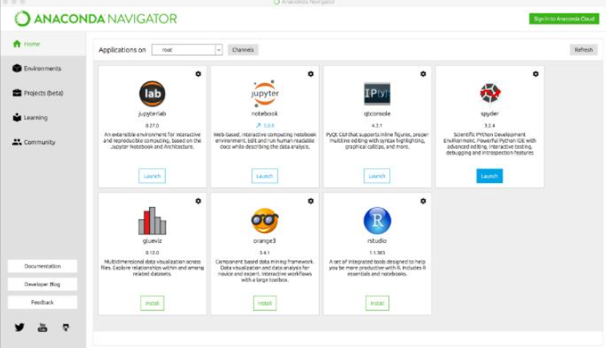

Slide 9
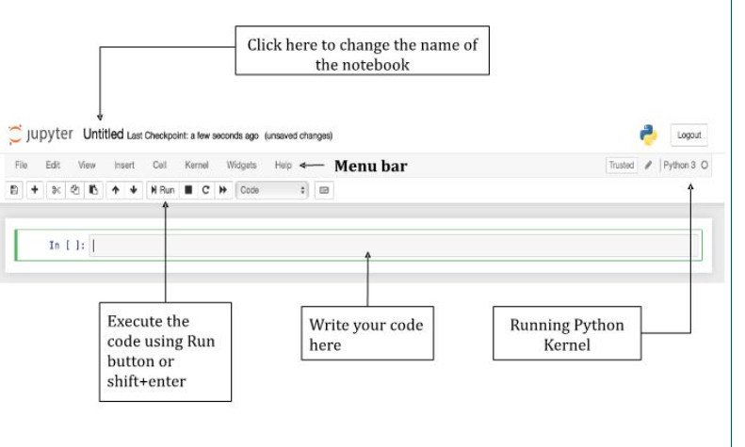

Slide 10
variables

Slide 11
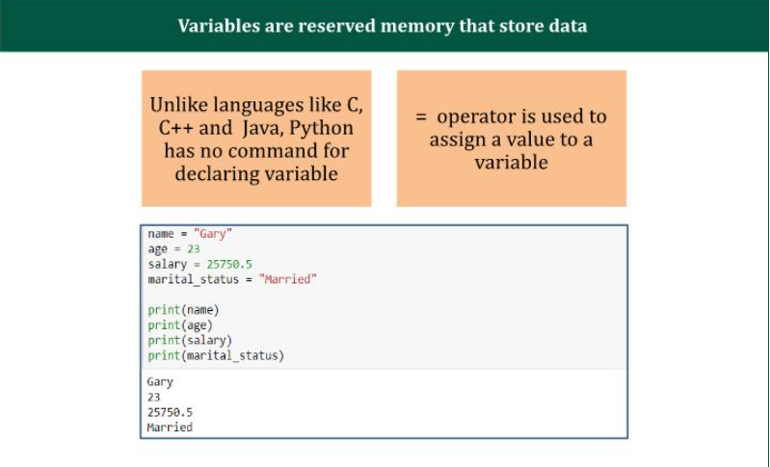

Slide 12
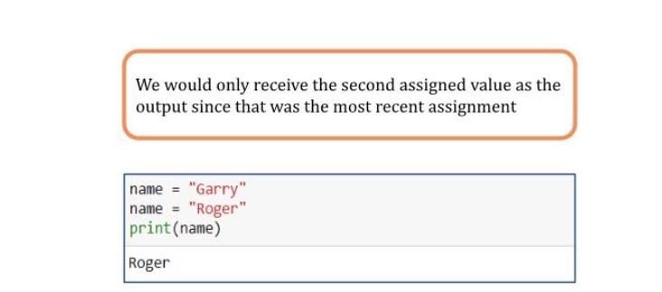
Reassigning variables

Slide 13
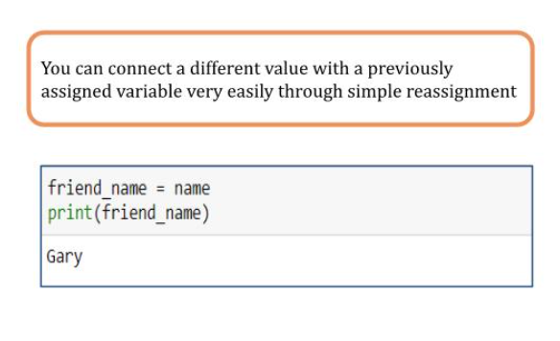

Slide 14
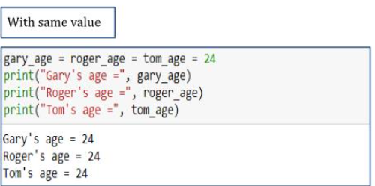
Multiple variable assignment

Slide 15
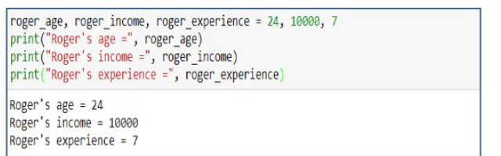

Slide 16
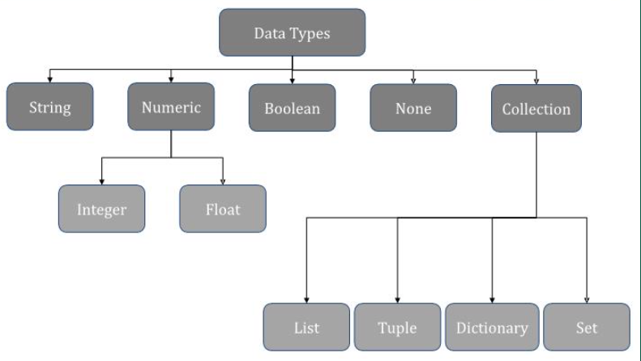

Slide 17
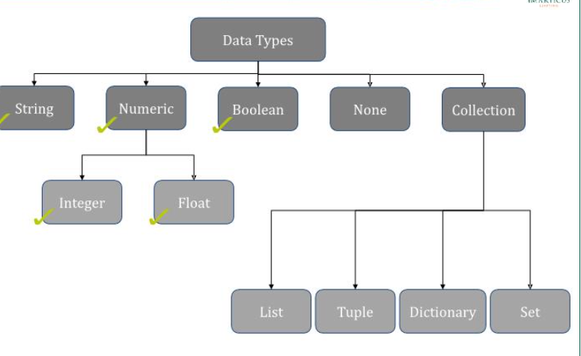
Important data types

Slide 18
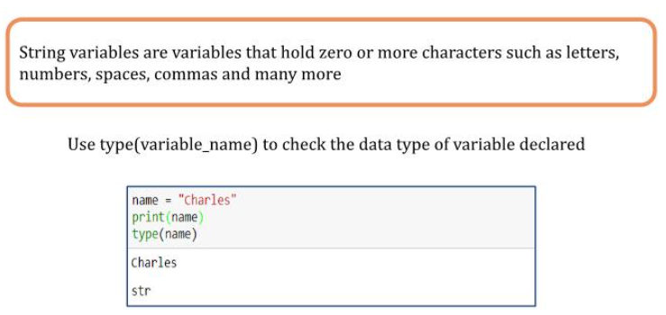

Slide 19
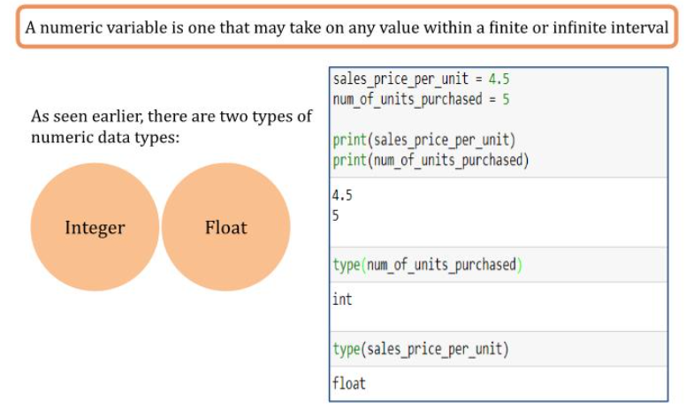

Slide 20
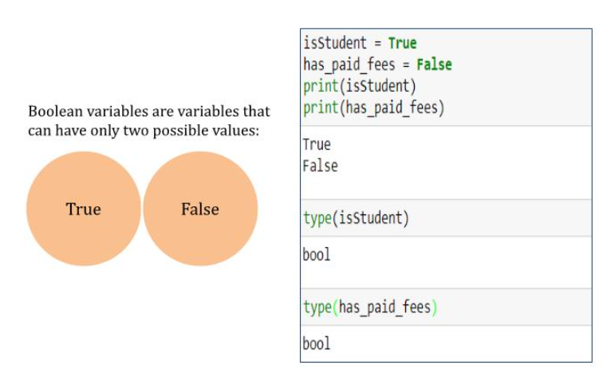

Slide 21
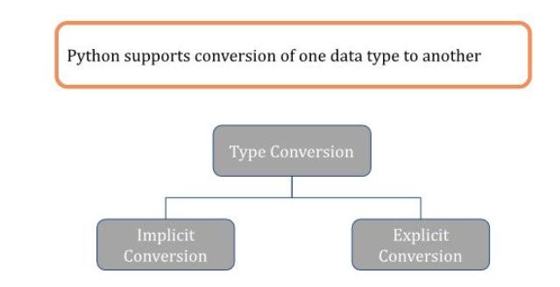
Data type conversion

Slide 22
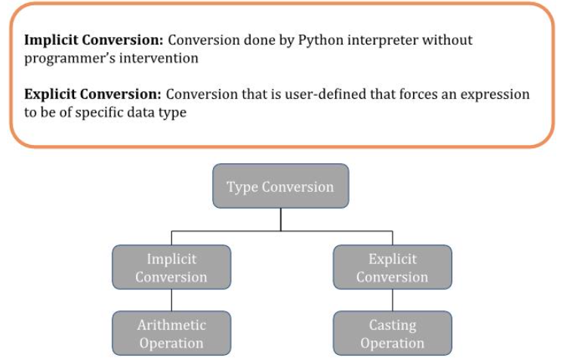

Slide 23
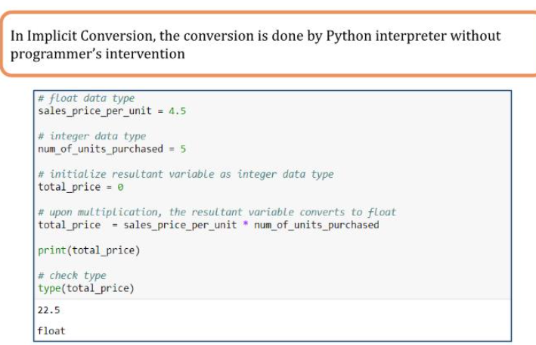

Slide 24
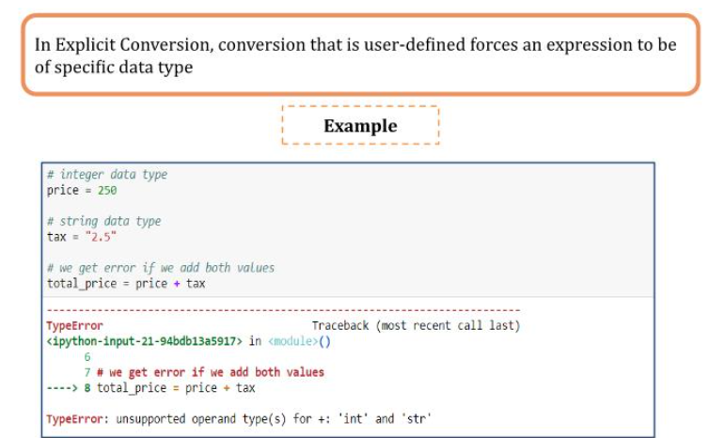

Slide 25
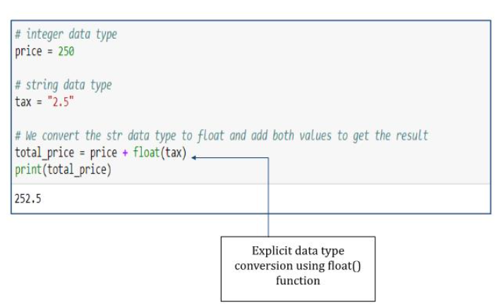

Slide 26
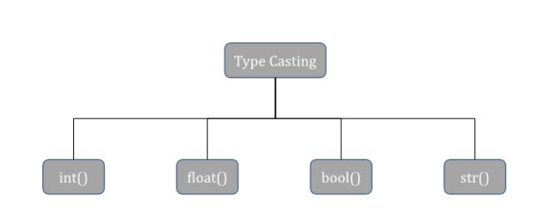

Slide 27
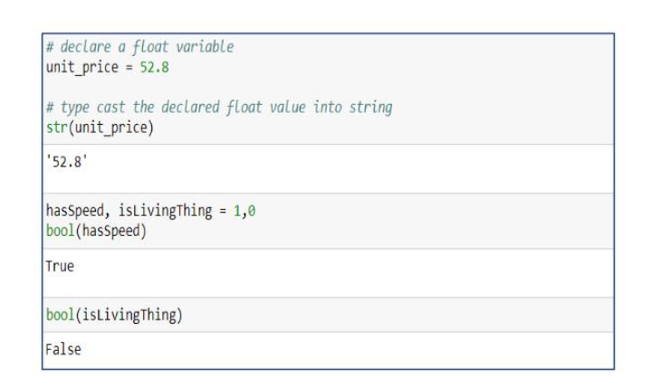
Type casting

Slide 28
functions

Slide 29
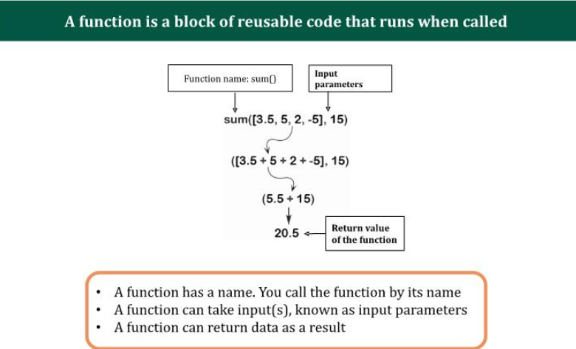
What are functions?

Slide 30
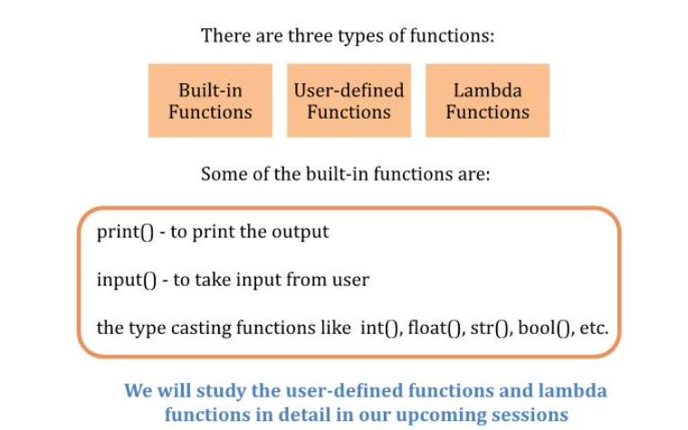

Slide 31
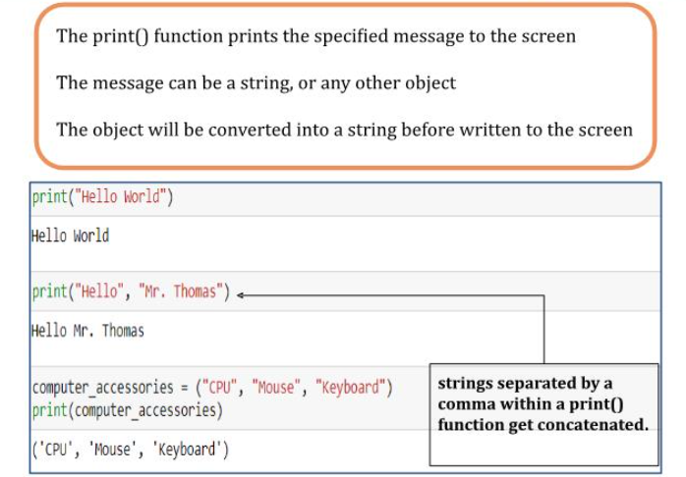
Print() in python

Slide 32
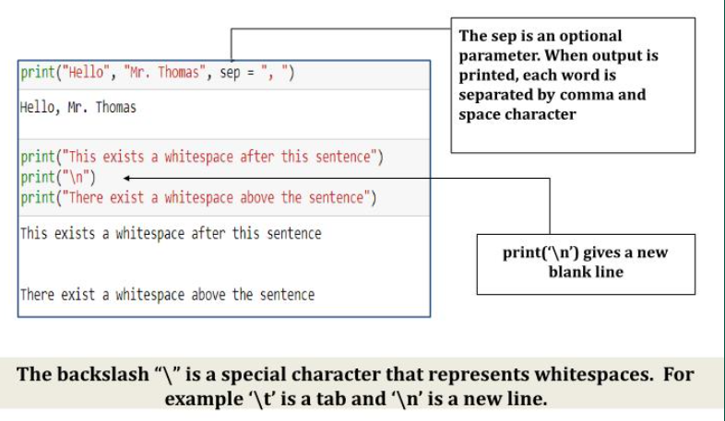

Slide 33
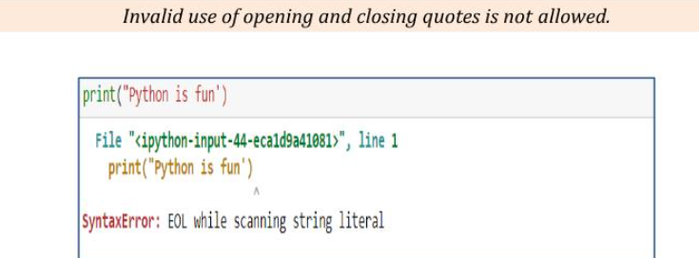

Slide 34
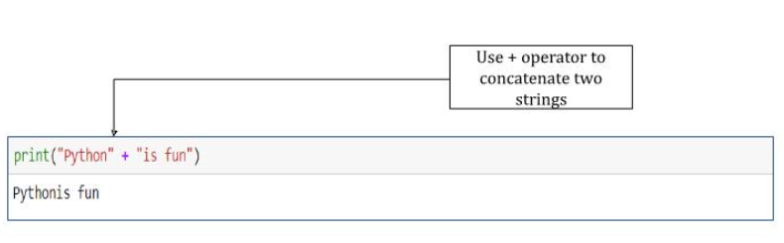
Concatenation using print()

Slide 35
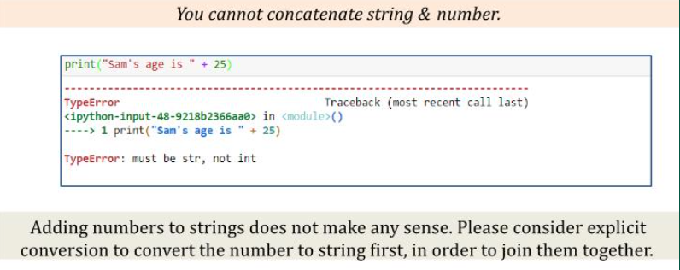

Slide 36
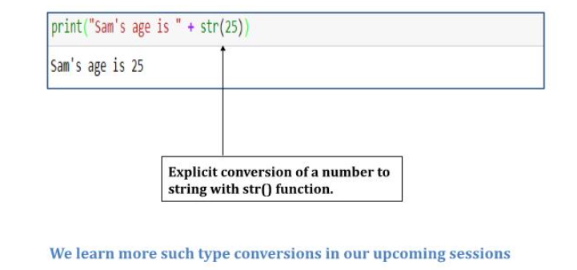
Concatenation with type caSting

Slide 37
Python operators

Slide 38
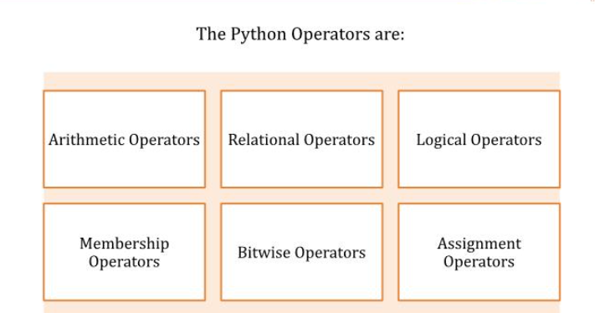

Slide 39
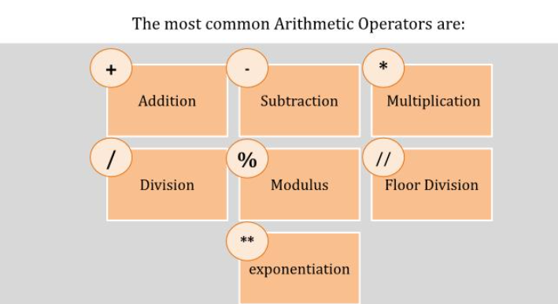

Slide 40
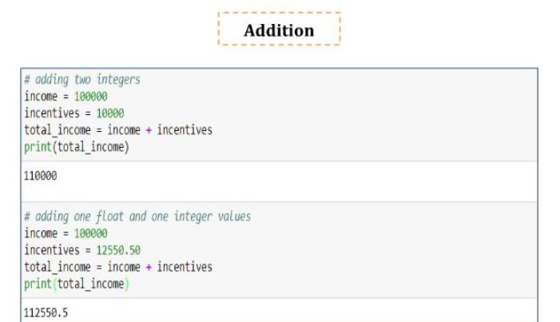
Arithmetic operators

Slide 41
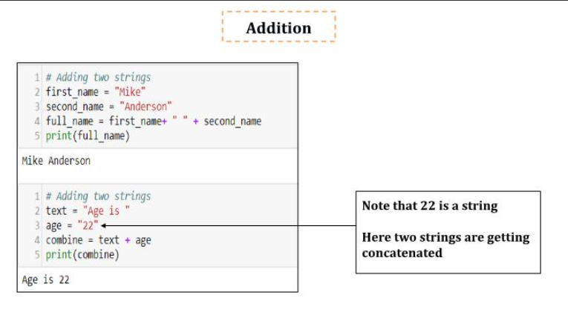

Slide 42
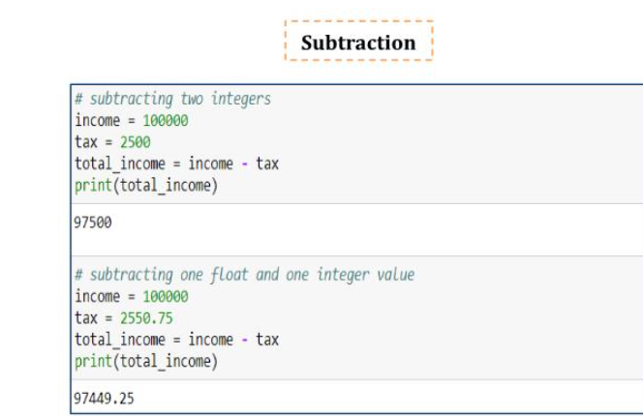
Arithmetic operators

Slide 43
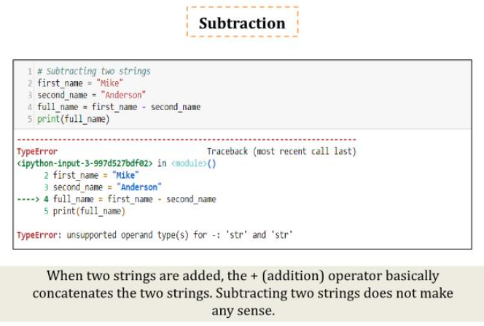

Slide 44
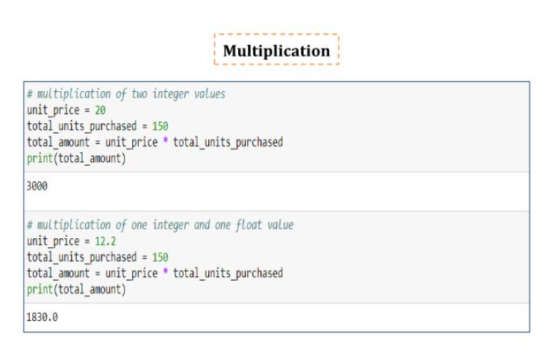

Slide 45
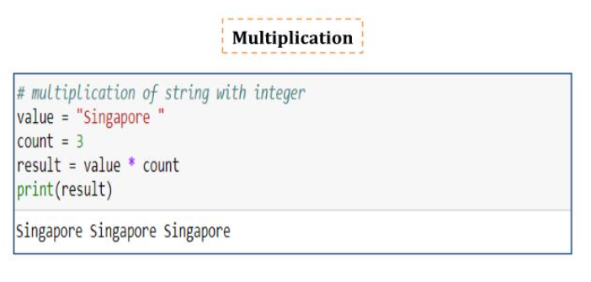

Slide 46
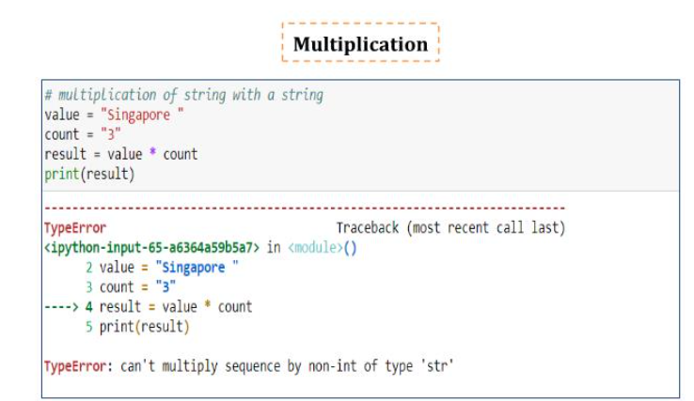

Slide 47
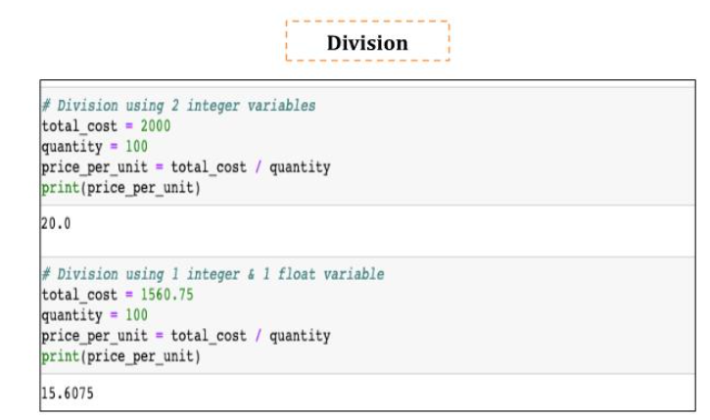

Slide 48
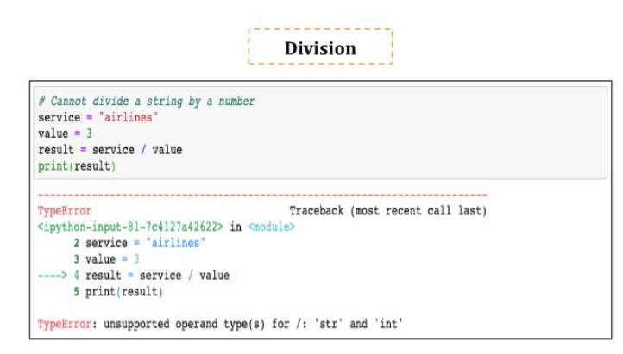

Slide 49
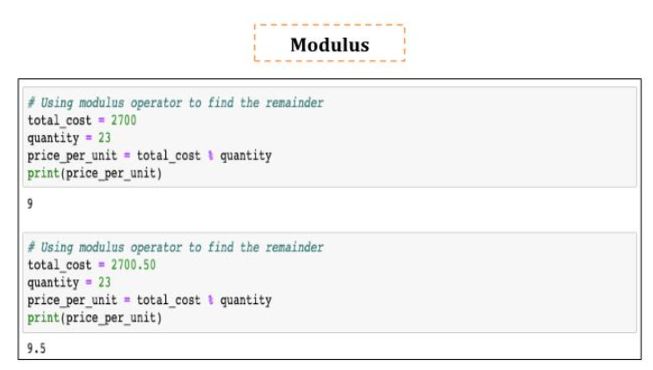

Slide 50
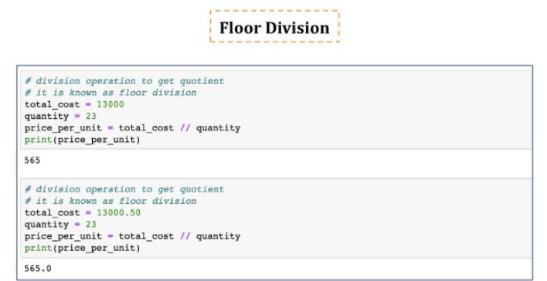

Slide 51
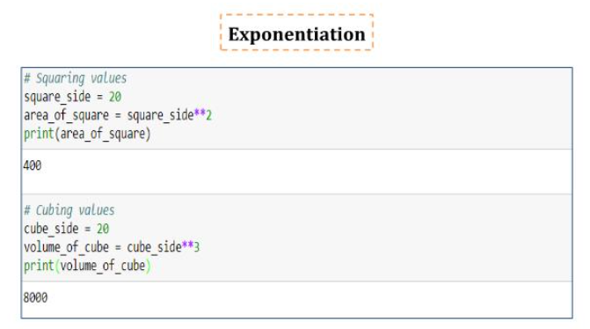

Slide 52
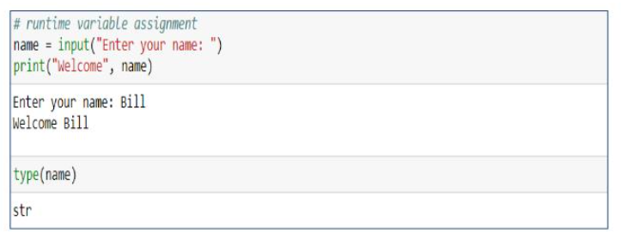
Runtime variable assignment

Slide 53
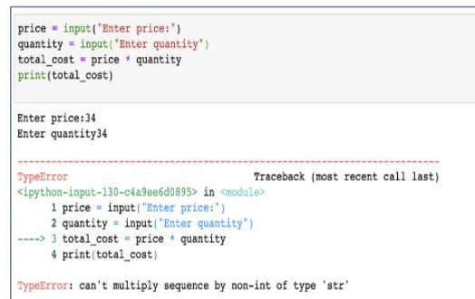

Slide 54
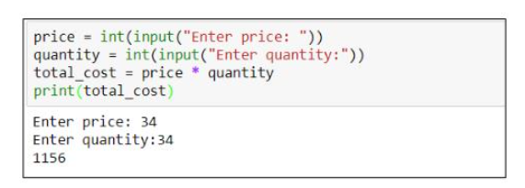

Slide 55

Relational operators

Slide 56


Slide 57

Logical operators

Slide 58


Slide 59


Slide 60


Slide 61

Membership operators

Slide 62


Slide 63


Slide 64

Some bitwise operators

Slide 65


Slide 66


Slide 67

More assignment operators

Slide 68
Python flow controls

Slide 69


Slide 70
Conditional statements

Slide 71

If statement

Slide 72


Slide 73

If-else statement

Slide 74


Slide 75

If elif else statement

Slide 76


Slide 77

Nested if else statement

Slide 78


Slide 79


Slide 80
loops

Slide 81

While loop

Slide 82


Slide 83

For loop

Slide 84


Slide 85


Slide 86

Getting out with break statement

Slide 87


Slide 88

Skip loop step with continue statement

Slide 89


Slide 90


Slide 91


